Slide 1
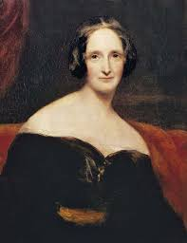
Mary Shelley/Frankenstein
“How far can we go in raising the dead without destroying the living?”

Slide 2
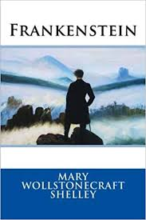
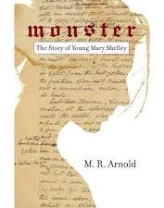
Texts that influenced our script:
Monster: The Story of Young Mary Shelley by M.R. Arnold
Frankenstein by Mary Shelley

Slide 3
Essential Questions:
What does it mean to be alive?
How do you define “life” and “death”?
How much does nature affect our development?
How much does nurture affect our development?
“How far can we go in raising the dead without destroying the living?”
Why do authors write fiction? Why did Mary Shelley create something so horrible and yet so beautiful?

Slide 4
Helpful Video Links
Biography, National Theatre
In Search Of History-Frankenstein, History Channel
Sparknotes Breakdown of Frankenstein
TED-ED: Everything you need to know to read Frankenstein

Slide 5
Now that we have explored the context of our story...
What did you learn about Mary Shelley or Frankenstein?
What do you consider to be key moments or important takeaways for our story?
What do we need to do to further understand the story/create a story?

